Slide 1
CSE 2102: Introduction to Software Engineering
Software Engineering Principles

Slide 2
What is a principle?

Slide 3
Why are principles needed?

Slide 4
Principles vs. Methods vs. Tools

Slide 5
Outline
by tools
Seven important principles that may be used in all phases of software development
Modularity is the cornerstone principle supporting software design

Slide 6
Key principles
Rigor and formality
Separation of concerns
Modularity
Abstraction
Anticipation of change
Generality
Incrementality

Slide 7
Rigor and formality: Motivation
Problem statement:
Write a program that computes the square root of a number
What is wrong/missing in this simple problem statement?
What is the range of numbers that will be accepted as input?
What is the output of the program if the input number is positive?
- Positive square root, negative square root, or both.
What is the output of the program if the input number is negative?
- Error message, complex root, or both?

Slide 8
Rigor and formality: Motivation
More rigorous problem statement:
Write a program to compute the square root of a given number. The
program accepts positive and negative numbers as well as zero as
input. If the input is a positive number, then the output should be
both positive and negative square roots of the number. If the input
is zero, then the output should be zero. If the input is a negative
number, then the program should print an error message and exit.
Tries to consider and anticipate all the situations.
Tries to define or specify precisely the behavior for all the situations.
Can you find anything lacking in this problem statement?

Slide 9
Rigor and formality: Motivation
Formality is rigor at the highest degree.
Use of mathematical equations to specify the behavior
SquareRoot(x)
Output = + sqrt(x), if x > 0
= 0 if x = 0
= “Error” if x < 0
Input x;

Slide 10
Rigor and formality
Software engineering is a creative design activity
  Creativity leads to imprecision and inaccuracy
Hence, it must be practiced systematically
Rigor is a necessary complement to creativity that increases our confidence in our development
  Rigor is necessary for thoroughness
Formality is rigor at the highest degree
  Software process driven and evaluated by mathematical laws

Slide 11
Rigor and formality (contd..)
Software engineers active partners in rigor and formality requirements
Rigor and formality strongly influence reliability and verifiability!
Rigor and formality impact across multiple phases of software design process
  Specification vs. Design vs. Implementation
  Maintenance vs. Evolution

Slide 12
Examples of rigor and formality
Product:
  Mathematical (formal) analysis of program correctness
  Systematic (rigorous) test data derivation
Process:
  Rigorous documentation of development steps helps project management and assessment of timeliness

Slide 13
Separation of concerns
Problem statement:
Write a program to compute the square root of a given number. The
program accepts positive and negative numbers as well as zero as
input. If the input is a positive number, then the output should be
both positive and negative square roots of the number. If the input
is zero, then the output should be zero. If the input is negative, the
Program should print an error message. The output should be
produced in 2 ms.
Different concerns:
Functional correctness for positive inputs
Robustness for negative inputs
Performance
Address different concerns separately:
First provide an implementation which is functionally correct.
Exception handling to handle negative inputs.
Replace the simple implementation by an efficient one to improve
performance.

Slide 14
Separation of concerns
Divide and conquer problem solving techniques
  Understanding dependencies among sub problems
    Which sub problems are (in)dependent?
    Can problem viewed from differing perspectives?
As application’s complexity increases
  Separate concerns
  Compartmentalize towards components
Identify the different aspects of problem
  Time considerations – Scheduling
  Focus on qualities of primary concern
    Address qualities separately for each problem
    Performance vs. Correctness vs. Interoperability
  Alternate views of problem – data vs. control
  Size-oriented decomposition

Slide 15
Separation of concerns (contd..)
Separation of concerns supports:
  Parallelization of efforts
  Separation of responsibilities
Software applications must be able to exploit hardware advances:
  Faster CPUs, more memory/disk
  Still exceeding workstation “capabilities”
Today’s applications involve interoperability of
  New C/S, Legacy, COTS, Databases, etc.
  Multiple programming languages (C, C++, Java, etc.)
  Heterogeneous hardware/OS platforms
Separation of concerns is critical

Slide 16
Examples
Go through phases one after the other (as in waterfall)
  Separation of concerns by separating activities with respect to time
Keep product requirements separate
  Functionality
  Performance
  User interface and usability

Slide 17
Modularity: Motivation
Problem statement:
Write a program to compute the square root of a given number. The
program accepts positive and negative numbers as well as zero as
input. The program accepts input from an ASCII file. If the input is a
positive number, then the output should be both positive and negative
square roots of the number. If the input is zero, then the output should
be zero. The output should be written to a file.
Should the code for input and output be embedded with the code
that computes square root, or should the code be in separate modules?

Slide 18
Modularity
Compose and design systems as set of modules
Two-phase application of separation of concerns
  Phase I: Module level
    Define details of individual modules
    What well-defined tasks does a module perform?
  Phase II: System level
    Characterize interactions among all modules
    What does a module need from other modules?
Methodological approaches:
  Top-down: Phase II followed by Phase I
  Bottom-up: Phase I followed by Phase II
Modularity inherent in engineering disciplines
Modularity transcends computing areas

Slide 19
Modularity (contd..)
Four benefits of modularity
  Decomposability: Problem to subproblems
  Composability: Combine subproblems to solution
  Understanding: Capability of understanding a system by understanding its pieces
  Modifiability: Capability of modifying a system by modifying its pieces.
Key supporting concepts: Cohesion and coupling
Cohesion:
  Degree to which parts of a module are related
Coupling:
  Modules have low interactions with others
  Understandable separately

Slide 20
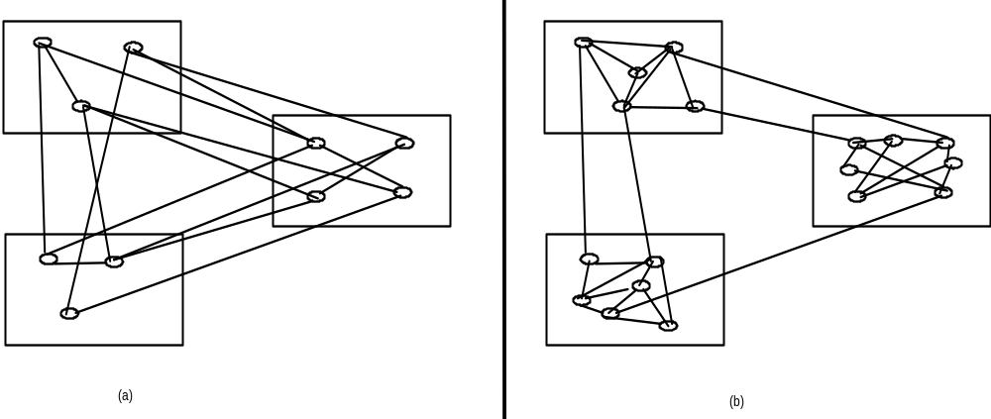
Modularity (contd..)
A visual representation of coupling
A
A
B
B
C
C
high coupling
low coupling

Slide 21
Modularity (contd..)
Modularity supported in programming languages
  “.h/.c” pairs
  Subdirectories at OS level or complier makes
  Ad-hoc modularity
C++
  “.h/.c” pairs for classes
  Adds abstraction, public interface, private implementation.
  Subdirectories at OS level or compiler makes
Ada95/Java
  Adds the package concept
  Rules for interactions/visibility within/among packages

Slide 22
Abstraction: Motivation
For a module, which uses the square root program, the only relevant
information is the input it accepts and the output it provides.
It need not be concerned with how the square root computation is
implemented.
Thus, the user of the square root program is only concerned with its
input/output behavior and may ignore the details of the implementation.

Slide 23
Abstraction
Identify the important aspects of a phenomenon and ignore its details
Special case of separation of concerns
Widely utilized to reduce complexity
People think and learn in abstractions
Goals of advances in design and programming
  Provide robust sets of abstractions
  Allow modeling to occur close to real world
The type of abstraction to apply depends on purpose
  Example : the user interface of a watch (its buttons) abstracts from the watch's internals for the purpose of setting time; other abstractions needed to support repair

Slide 24
Abstraction (contd..)
Abstraction yields models
  For example, when requirements are analyzed we produce a model of the proposed application.
  The model can be a formal or semiformal description
  It is then possible to reason about the system by reasoning about the model.

Slide 25
Example
Programming language semantics described through an abstract machine that ignores details of the real machines used for implementation
  Abstraction ignores details such as precision of number representation or addressing mechanisms
Abstractions in process
  When we do cost estimation we only take some key factors into account
  We apply similarity with previous systems, ignoring detail differences

Slide 26
Anticipation of change: Motivation
Problem Statement:
Consider the square root program. In addition to accepting input and
writing output to a file, the program should also accept input from a
terminal and provide output to a terminal.
File i/p
Square root
File o/p
Terminal i/p
Terminal o/p
What if a combination of file and terminal I/p and o/p is desired?

Slide 27
Anticipation of change: Motivation
Another example:
Initially, the user wants an error message if the input is negative.
Later, he changes his mind, and wants the complex root as output.

Slide 28
Anticipation of change
Software changes and evolves throughout all stages from specification onward
Key is to anticipate future changes
Once anticipated, encapsulate areas for potential changes into targeted portions of product
Is anticipation of change unique to computing?
Handling anticipation of change
  Basis of evolvability and reusability
  Requires automated support (SCCS, etc.) for configuration and version management
  Impacts software production process
Can future products be predicted?
Is planning cycle 5 or more years?

Slide 29
Generality: Motivation
Square root routine is being written for use in an application where its
input will never be negative.
- A quick solution will be write a program that does not handle
negative numbers at all.
Later, a new application needs square root computation. But this,
time, the output should be a complex root, if input is negative.
- If the original program considered the case of general numbers,
it could be reused in the new application.

Slide 30
Generality
While solving a problem, try to discover if it is an instance of a more general problem whose solution can be reused in other cases
  Supermarket system vs. Inventory control
  Hospital application vs. health care product
Adapt general solution to specific problem
  Inventory control for supermarket, auto parts, video tape rental, etc.
  Health care product for hospital, MD office, dental office, etc.
Carefully balance generality against performance and cost
Sometimes a general problem is easier to solve than a special case

Slide 31
Generality (contd..)
Domain and organization specific reuse
What products will company develop in the future?
Leverage additional short-term effort with long-term gains with respect to maintenance, reuse, etc.

Slide 32
Generality (contd..)
Three classes of software
in a typical software application
Domain-Independent
Domain-Specific
20%
65%
Application-Specific
15%

Slide 33
Incrementality: Motivation
To provide a quick solution, we may first write a program that accepts
positive numbers as input, and provides positive square root as output.
Later, we can add the capability to accept negative numbers as input.
Depending on the experience of the user in using the original program,
upon receiving a negative input, he may choose to:
- Print an error message
- Produce complex root

Slide 34
Incrementality
Accepted practice across disciplines
  Construction of houses and major projects
  Win 3.1, Win 95, Win 98, etc.
An engineering approach to problem solving
Difficult to anticipate what to build
  Would you have guessed the role of social media 5 years ago?
  Can’t be ignored for “future products”
  Future tools browser look-and-feel
Accepted practice in computing
  Alpha and Beta versions
  Adding features and tuning for performance

Slide 35
Incrementality (contd..)
Products are built in increments
  Quicker to market
  Focused, less errors in smaller increments
  Phased prototypes with increasing functions
Difficulty in constructing solutions to complex computing problems
  Utilize rapid prototyping to discern requirements from users
  Allow designers/developers to learn domain
  Add classes for successive prototypes
  Include new functionality in existing classes

